Slide 1
DIGITAL PORTFOLIO
STUDENT NAME: Manikandan G
REGISTER NO AND NMID: FECC364BB1E4D218CEF47CDFB10D3EC5
DEPARTMENT: II BCA
COLLEGE: Prince Shri Venkateshwara Arts and Science College/Madras University

Slide 2
PROJECT TITLE
Digital Portfolio

Slide 3
AGENDA
Problem Statement
Project Overview
End Users
Tools and Technologies
Portfolio design and Layout
Features and Functionality
Results and Screenshots
Conclusion
Github Link

Slide 4
PROBLEM STATEMENT
In today’s competitive world, it is difficult to stand out without a professional online presence.
Traditional resumes are limited and do not showcase projects interactively.
Many students and professionals struggle to demonstrate their skills to recruiters and clients.
There is a need for a responsive and user-friendly portfolio that highlights achievements, skills, and personal brand.

Slide 5
PROJECT OVERVIEW
The project is a personal portfolio website built to present:
Educational background
Technical skills
Professional projects
Contact details
Designed with a modern and minimal layout.
Acts as a digital resume and showcase for recruiters, clients, and institutions.
The portfolio improves visibility, builds credibility, and supports career growth.

Slide 6
WHO ARE THE END USERS?
Recruiters: To evaluate candidates’ skills and achievements.
Employers: To identify suitable candidates for job roles.
Clients: To verify design and project capabilities before hiring.
Academic Institutions: For admissions, internships, or project reviews.
Professional Networks: To showcase expertise among peers.

Slide 7
TOOLS AND TECHNOLOGIES
Frontend: HTML5 for structure, CSS3 for styling, JavaScript for interactivity.
Version Control: Git for version tracking, GitHub for hosting and sharing code.
Design Principle: Responsive Web Design to ensure compatibility with desktop, tablet, and mobile.
Optional Frameworks: Bootstrap or Tailwind CSS for faster and consistent design.

Slide 8
PORTFOLIO DESIGN AND LAYOUT
Sections included:
- About Me – Short introduction about education and passion.
- Skills – Programming and technical expertise.
- Projects – Detailed showcase of completed works.
- Contact Me – Email, phone number, and website links.
Design elements:
- Simple, clean, and modern layout.
- Consistent color scheme for professionalism.
- Responsive design ensuring accessibility on all devices.

Slide 9
FEATURES AND FUNCTIONALITY
- Fully responsive design that adapts to screen size.
- Smooth navigation with menu and scrolling.
- Dedicated section to showcase projects with description and images.
- Contact form integration for communication.
- Links to social media and GitHub repository.
- Easy to update with new projects and skills.

Slide 10
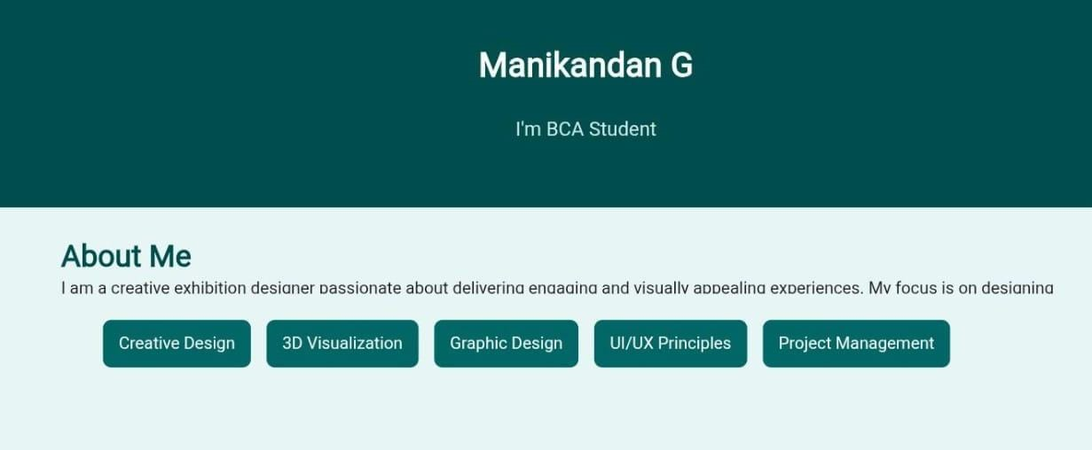
RESULTS AND SCREENSHOTS

Slide 11
CONCLUSION
The project successfully created a personal portfolio website.
It addresses the problem of limited digital visibility.
Provides a strong platform for professional growth.
Can be further enhanced by adding:
More projects
Advanced UI animations
Blog or achievements section

Slide 12
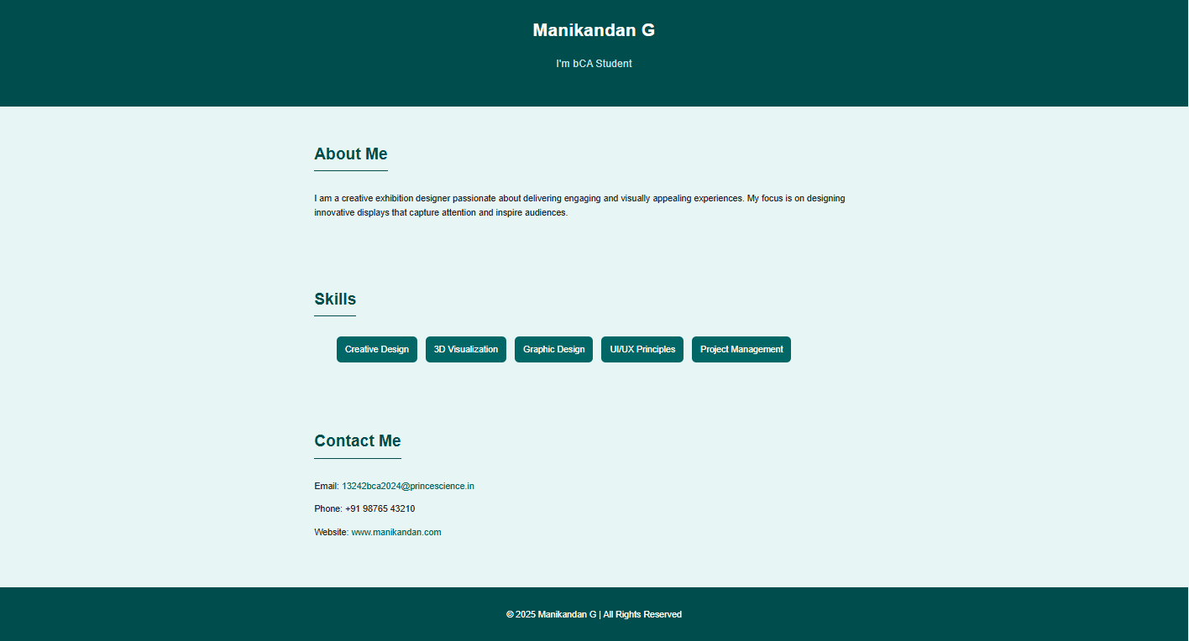

Slide 13
GITHUB LINK
GitHub Repository:
👉 https://github.com/your-username/your-portfolio
Source code is available for future updates and contributions.

